Slide 1
www.shareforyou.org
Sexual Health and Relationship Education-SHARE

Slide 2
South Texas Pregnancy Care Center …..
The South Texas Pregnancy Care Center is a 501(c)3organization. We are solely supported by generous donations of individuals, businesses and churches in the Seguin and surrounding area.
The South Texas Pregnancy Care Center is a faith-based organization! However, the SHARE program is not. All facts, figures, opinions, and statements embedded in the curriculum of SHARE is scientific and medically accurate information. Most of the information comes from the Centers for Disease Control and Prevention, the CDC.

Slide 3
Mission Statement
SHARE’s mission is to positively influence young people’s sexual behavior by educating them about the benefits of sexual risk avoidance (abstinence) and to encourage informed decision making through the use of factually documented information. We believe that students can make positive decisions if they are well informed!

Slide 4
What exactly is Sexual Risk Avoidance education?
SRA is a sex education approach based on a public health model known as “risk avoidance” or “abstinence”.
It is the standard approach used to address risky behaviors such as underage drinking and smoking and is entirely appropriate and beneficial in addressing the risk of teen sex.
It differs from a “risk reduction” model in that it seeks to help individuals eliminate all risk as opposed to simply reducing risk. It helps to foster a culture of high expectations for all youth.

Slide 5
Does the SRA approach work?
There are currently 25 peer-reviewed studies showing that students in SRA classes are: a) more likely to delay sexual initiation, and b) if sexually active, more likely to discontinue or decrease sexual activity and no less likely to use a condom.¹
This model of teaching also goes beyond just the physical consequences such as teen pregnancy and STIs/STDs. Our comprehensive approach emphasizes and connects the value of avoiding sex to key components that help adolescents thrive and succeed.
SHARE programming has, on average in high school an increase from 44% to 55% of students saying they are planning to wait for marriage or a lifetime relationship for sex . 74% of students indicate that the presentations changed their views on waiting for sex.
¹ The US Department of Health and Human Services & the Administration for Children and Families (2007, May). Review of Comprehensive Sex Education Curricula.² CDC (2018) Youth Online: 2017 YRBS Survey Results. Atlanta: Author

Slide 6
Alignment
SHARE is aligned with the TEKS required by Texas educators and school districts.
SHARE is a three-day program, teaching students in their classrooms.
SHARE focuses on teen pregnancy, sexually transmitted diseases and building healthy relationships.

Slide 7
STPCC purchased the SHARE program in 2015. We piloted the program in the 2016-17 school year with Navarro Jr. High and Hallettsville Middle School and ninth and tenth graders from Hallettsville High School.
In 2017-18, SHARE was presented in five school districts, teaching 3,375 middle and high school students. (La Vernia – 6th – 12th graders, Luling - 6th – 12th graders, Hallettsville 7th – 10th graders, Gonzales 7th – 8th graders, and Seguin High School Health Occupations Classes.
In 2018-19, SHARE presented programs in these schools with the exception of Seguin HS.
In 2019-2020, SHARE presented at Navarro Junior High, Luling Junior High and High School, La Vernia High School, Hallettsville Junior High and High School, and 5th-10th graders in Gonzales ISD in late.
This year, SHARE has returned and expanded in Navarro ISD and has returned to Hallettsville Junior and High School. Gonzales ISD presentations for 6th grade are this week and 7th and 8th grade will be in May. Gonzales HS has asked us to present after the STARR testing.

Slide 8
Middle School Program (6th-8th)
Day 1 – Guard your heart:
Setting goals, setting boundaries, the importance of friends, teen pregnancy, understanding relationships.
Day 2 – STD/STI presentation:
What are STDs? How to prevent getting an STD.
Day 3 – Relationships:
Consequences of risky sexual behavior, sexting, internet safety and social media influences.

Slide 10
8th Grade SHARE 2019 Results for Gonzales Junior High School
Pre-test Post-test

Slide 11
Choices
The SHARE program is here, not to tell you what to do, but to give you information so you can make good, healthy choices and be prepared for your future.

Slide 12
CDC, 2018; YRBS, 2017; ACT for Youth, 2019; Nemours, 2018; Power to Decide, 2018; Mayo Clinic, 2017
Nemours, 2015; Perkins, 2015; ACT for Youth, 2018; CDC, 2018; YRBS, 2017
Notes:
Same sex partners have often been with someone of the opposite sex, especially teens. It applies to everyone
Being interested in someone of the same sex does not necessarily mean that a person is gay — just as being interested in someone of the opposite sex doesn't mean a person is straight. It's common for teens to be attracted to or have sexual thoughts about people of the same sex and the opposite sex. It's one way of sorting through emerging sexual feelings.
Some people might go beyond just thinking about it and experiment with sexual experiences with people of their own sex or of the opposite sex. These experiences, by themselves, do not necessarily mean that a person is gay or straight.
Nemours. “Sexual Attraction and Orientation.” Teen Health. Nemours Foundation. Oct. 2012. Web. 08 Sept. 2015. <http://kidshealth.org/teen/sexual_health/guys/sexual_orientation.html>. Reviewed by: D'Arcy Lyness, PhD, and Neil Izenberg, MD
Awareness of romantic attraction typically begins prior to puberty [1]. Sexual attraction, behavior, and identity are not always aligned: a person primarily attracted to women may also have sexual contact with men and may or may not identify as gay, bisexual, or straight. This fluidity may be true of both adolescents and adults, and is seen more frequently among females [2]. McClintock, M. K., & Herdt, G. (1996). Rethinking puberty: The development of sexual attraction. Current Directions in Psychological Science, 5. Retrieved May 19, 2015, from homepage.univie.ac.at/Michael.Berger/lit/McClintock.pdf Accessed Web. 09 Sept. 2015. <http://www.actforyouth.net/adolescence/demographics/sexual_health.cfm>.
[2] Saewyc, E. M. (2011). Research on adolescent sexual orientation: Development, health disparities, stigma, and resilience. Journal of Research on Adolescence, 21, 256-272. doi:10.1111/j.1532-7795.2010.00727.x. Accessed Web. 09 Sept. 2015. <http://www.actforyouth.net/adolescence/demographics/sexual_health.cfm>.
ACT for Youth Center of Excellence. “Demographics: Sexual Health.” Adolescence. 2015. Web. 09 Sept. 2015. <http://www.actforyouth.net/adolescence/demographics/sexual_health.cfm>.

Slide 13
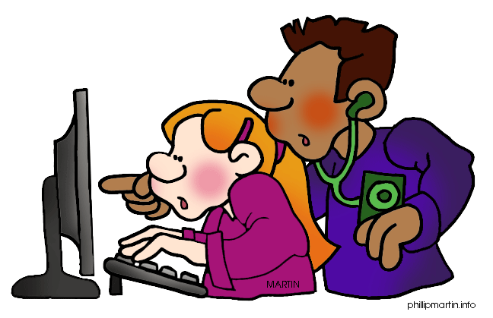
Crash and Tell
The Best Strategy for Dealing with Porn Exposure
1. Turn off the screen or the computer.
2. Tell an adult.
3. Never visit the site again.
If someone shows you an inappropriate site, don’t be afraid to walk away.

Slide 14
Resisting Pressure
Plan it!
Say it!
Do it!
Avoid Peer Pressure and Make Good Choices

Slide 15
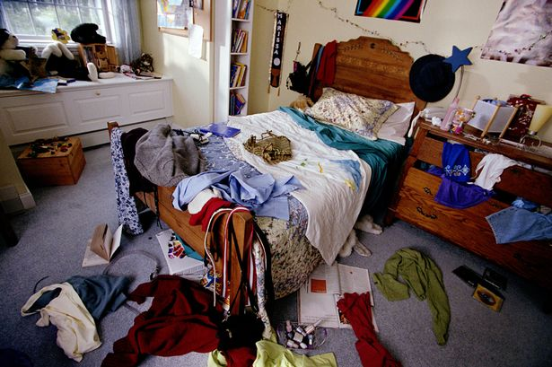
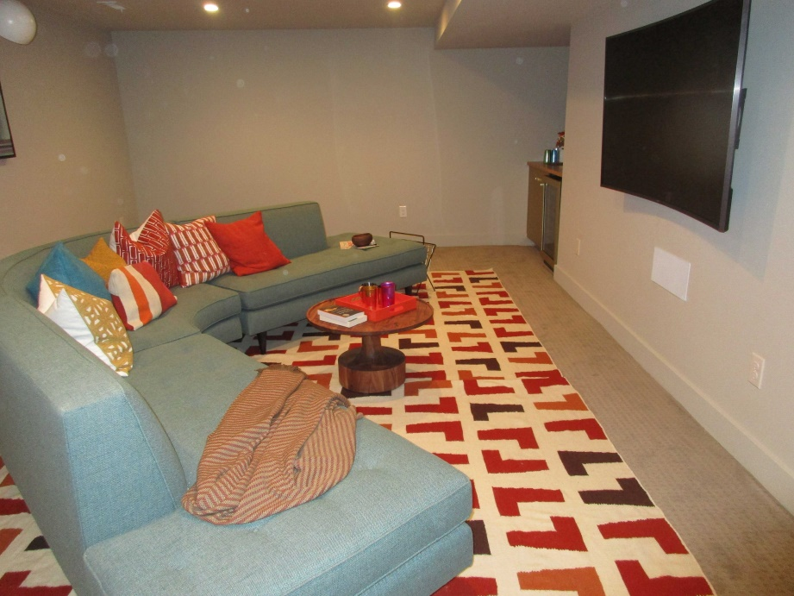
Don’t
Go to
Intimate Places

Slide 17
How to decrease/eliminate your chance of ever getting an STI:
WAIT to have sex!
2. Stay away from drugs & alcohol.
3. Surround yourself with good friends.

Slide 18
Genital Herpes~Herpes Simplex Virus
Viral - no cure!
VERY COMMON!
1 out of 6 people 14-49
have Genital Herpes 2
Only 20% know they have it
How you get it:
Any kind of Sex
Genital skin to skin contact
Mother to baby
Condoms cannot completely protect a person from Herpes or from spreading it to others.
Notes:
One million people acquire genital herpes infections each year in the US.
One in 6 have it 14 – 49
One out of 5 women
One out of 9 men cdc fact sheet Sept 2012
80% of the people with the disease don’t know they have it, yet they are still contagious even if they have no sores.
Viral STD – no cure, you have it for LIFE!
HSV type 1 – commonly infects the mouth and lips, know as cold sores. Can cause sores in genital area.
HSV type 2 – usually causes sores in genital area, but can also infect the mouth.

Slide 19
HPV lesions
Notes:
http://babyboomeradvisorclub.com/2008/10/10/who-should-get-the-hpv-vaccine-gardasil-for-genital-warts-no-one/
This is the article where the first pic is from . They are genital HPV warts but a “safe” picture for middle schoolers.

Slide 20
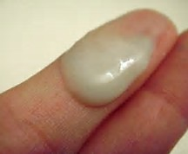
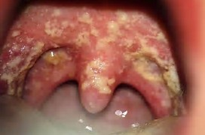
Chlamydia
Condoms reduce but do not eliminate risk
Discharge from penis or vagina
Type: Bacterial
Transmitted: Vaginal, oral, or anal sex
Symptoms: Mild to none, can have discharge
Risks: Can cause pain and if left untreated. Chlamydia can make it difficult for a woman to get pregnant.
Testing: Specimen or urine
Treatment: Antibiotics

Slide 21
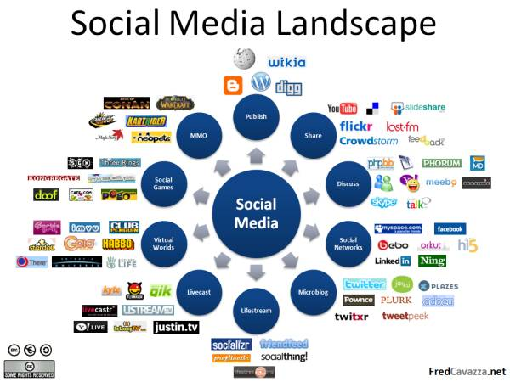

Slide 22
Sex Sells
Sex is attractive and students are naturally curious. So, they use images and suggestive pictures in their advertising to attract (hook) you.

Slide 23
Pornography is any sexually explicit image, writing, or other material whose primary purpose is to cause sexual arousal.
…what might be some of the problems with pornography?
…what makes pornography an unhealthy thing?
…what kind of a person do you imagine when you think of someone who uses pornography?
…what problems does pornography create in relationships?

Slide 24
93% of boys……
Largest group of internet porn users are between the ages of 12-17…..
Most statistics on pornography use say the average age of a child's first exposure to pornography is 11 years old.
…. Are exposed to internet porn before age 18….
62% of girls…

Slide 25
Once you post, you lose control. What if you accidentally sent it to your grandmother?
Notes:
Under Michigan law it is illegal to: persuade, induce, entice, or knowingly allow a minor to engage in a sexually explicit activity – 20 years jail or file of up to 100,000
If you distribute, promote or finance an image of a minor – 7 years in jail or fine up to 50000
If you knowingly possess an image of a minor in an act 4 years in jail or file up to 10000
Before you send a naked picture or hot text ask yourself – would I want my grandma to see this?

Slide 26
How Do I Do It?
Set your standards and stick to them
Establish healthy relationships without sex
Keep your eye on the prize!
Know your limits/group date
Watch the drugs and alcohol
Practice self-control
Establish an escape plan
Say NO! and walk away
Cutlip, 2017
Notes:
What is one short term thing that you can do? Research shows that these short term steps are effective.) Focus on the intermediate short term successes.
Too many teens say they have been pressured to do something sexual that made them uncomfortable or took them farther sexually than they wanted to go. This Survey Says explores those issues with detailed information on sexual pressure among teens by race/ethnicity, age, and sex.
Publication date: February 2014
Suggested Citation(s): The National Campaign to Prevent Teen and Unplanned Pregnancy. (2014). Survey Says: Under Pressure. Washington, DC: Author.
Remember what the CDC says, there are many things to consider when having sex and you can say “no”.
What if I decide to wait and someone tries to pressure me into sex?
If you have decided to wait, think about what you will say ahead of time if someone pressures you to have sex. ACOG. “You and Your Sexuality (Especially for Teens).” Especially for Teens. FAQ 042. ACOG. Aug. 2015. Web. 10 Sept. <http://www.acog.org/Patients/FAQs/You-and-Your-Sexuality-Especially-for-Teens>.
Under Pressure: Read the slide. Too many teens say they have been pressured to do something sexual that made them uncomfortable or took them farther sexually than they wanted to go. (National Campaign, 2014) This is what often leads to more regret. CLICK Read the slide. (Kramer, 2014) If you have decided to wait, think about what you will say ahead of time if someone pressures you to have sex. It’s way too easy to say yes or be caught up in the moment. You need to be intentional and have a plan. (ACOG, 2015) Practice the refusal skills you learn for drugs, etc. They’ll work for sex, too!

Slide 29
Questions?
Sarah Anderson, SRAS
SHARE Lead Teacher
sanderson@southtxpcc.com

